Slide 1
Nervous system toxicity
Lec 4
Dr. Afrah

Slide 2
Neurotoxicants
Are substances that causing toxic effects for the nervous system whether central or peripheral NS.
The nervous system is protected by blood brain barrier
To be neurotoxic ; molecules must pass through membranes not in between.
BBB contain transporters that transport molecules out of brain cells and back them into blood these transporters are called P – glycoproteins ( multidrug resistant proteins ).
The blood–brain barrier is incompletely developed at birth and even less so in premature infants. This predisposes the premature infant to brain injury by toxicants, such as unconjugated bilirubin

Slide 3
Mechanism of neurotoxicity
Neuropathy
Resulting from the death of the entire neuron
Axonopathy
Occurs when the axon is the primary site of injury
Myelinopathy
Resulting from disruption of myelin or selective injury to the myelinating cells
Demyelination
Loss of myelin sheath with preservation of axon

Slide 4
Interruption of the process of neurotransmission, which occur by many processes:
Interrupt impulse transmission
Block trans-synaptic communication
Block reuptake of neurotransmitter
Interfere with second messenger

Slide 5
Types of neurological effects
Short term effects :
These are reversible effects
Can be antagonized by an antagonist drug
Long term effects :
These are irreversible effects
Cannot be antagonized

Slide 6
Substances associated with neurotoxicity
Methyl mercury :
It is organometallic cation ( CH3Hg+ X- )
The clinical picture of Me-Hg poisoning varies with both the severity of exposure and the age of the individual at the time of exposure :
In adults, the most dramatic sites of injury are the neurons of the visual cortex and the small internal granular cell neurons of the cerebellar cortex, whose massive degeneration results in blindness and marked ataxia.
In children, developmental disabilities, retardation, and cognitive deficits occur. These differences are caused by an immature blood–brain barrier causing a more generalized distribution of mercury in the developing brain.

Slide 7
Mechanism of methyl mercury toxicity
Binding with -SH group
Alteration of NT release
Blocking voltage dependent Ca2+ and Na+ channels

Slide 8
Organophosphorous compounds
OP compounds are used as insecticides and chemical warfare agents
The OP insecticides and nerve agents are designed to inhibit AChE, thereby causing accumulation of acetylcholine in cholinergic synapses resulting in cholinergic toxicity and death.
Some OP compounds, such as tri- o -cresyl phosphate (TOCP) are neuropathic and can cause a severe sensorimotor central peripheral distal axonopathy called OP compound-induced delayed neurotoxicity (OPIDN) . This condition is also referred to as a delayed neuropathy.
OPIDN due to phosphorylation of neural target proteins, such as various serine hydrolases ( neuropathy target esterase , NTE)

Slide 9
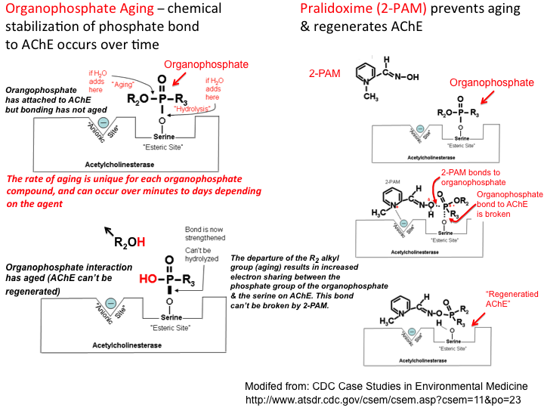

Slide 10
Lead
Toxic effect of lead is variable between individuals ( depending on many factors )
Children affected more than adults because of :
Lead absorption in children more than adults
Less protection of BBB
Toxic effects in children differs from toxic effects in adults
Signs and symptoms of acute toxicity differs from those occur in chronic toxicity
Chronic lead intoxication in adults results in peripheral neuropathy, often accompanied by manifestations outside the NS, such as gastritis, colicky abdominal pain, anemia, and the prominent deposition of lead in particular anatomic sites, creating lead lines in the gums and in the epiphyses of long bones in children.
Other findings : axonopathy including motor axons, and lead encephalopathy.

Slide 11
Mechanism of lead toxicity
Binding with sulfhydryl group inhibiting some enzymes
Inhibition of cellular function requiring calcium

Slide 12
Lead neuropathy
Lead neuropathy can be due to :
Decreased oligodendrite density
Myelin deposition
Blockage of voltage-sensitive calcium channels
Interference with neurotransmitters

Slide 13
Lead encephalopathy
It can occur during exposure to high levels of lead especially in children ( during acute toxicity )
It is characterized by cerebellar hemorrhage, increased blood-brain barrier permeability, and vasogenic edema) extracellular accumulation of fluid resulting from disruption of the blood-brain barrier (BBB) and extravasations of serum proteins, while cytotoxic edema is characterized by cell swelling caused by intracellular accumulation of fluid.

Slide 14
Neurotoxic affecting neurotransmission
Nicotine
Act by binding with nicotinic receptors that located in ganglia, NMJ, and CNS.
Nicotinic effect on sympathetic ganglia will lead to :
Acceleration of heart rate
Elevation of blood pressure
Constriction of blood vessels within the skin.
Nicotine leads to a sensation of “relaxation” and is associated with alterations of electroencephalographic (EEG) recordings in humans. These effects are probably related to the binding of nicotine with nicotinic receptors within the CNS, and the EEG changes may be blocked with mecamylamine, a nicotinic antagonist.

Slide 15
Cocaine
Mechanism of cocaine toxicity :
Block the reuptake of amines
Release of DA from storage vesicles
Toxic effects of cocaine include :
Euphoria and addiction
Increased self confidence
Paranoid psychosis
Cerebral atrophy
Increased risk of stroke and intracranial hemorrhage
Neurodegenerative disorders

Slide 16
Amphetamines
Mechanism of amphetamine toxicity :
Damage of monoaminergic cells directly by affecting catecholamine NT in CNS
Acting on dopaminergic neurons
Damaging 5 – HT axons
Production of free radicals from dopamine oxidization

Slide 17
Chemicals affecting astrocyte function
Ammonia :
Liver failure lead to accumulation of ammonia which will lead to brain ammonia ( NH4+ )
The effects of ammonia on the CNS vary with its concentration : At high CNS concentrations ammonia produces seizure, resulting from its depolarizing action on cell membranes, whereas at lower concentrations, ammonia produces stupor and coma, consistent with its hyperpolarizing effects.

Slide 18
Ammonia intoxication is associated with astrocytic swelling and morphological changes yielding the so-called Alzheimer type II astrocytes
Increased intracellular ammonia concentrations have been implicated in the inhibition of neuronal glutamate precursor synthesis, resulting in diminished glutamatergic neurotransmission, changes in glutamate uptake, and changes in receptor – mediated metabolic responses of astrocytes to neuronal signals

Slide 19
Chemicals associated with axonopathy
n – hexane
MFO
2,5 – hexanedione
Pyrrole – cross linking proteins
O2
Positive pyrrole molecule
Cross linking with NH2 - proteins + SH - proteins

