Slide 1
The digestive system

Slide 2
The digestive system:
The digestive system is composed of a continuous tract beginning with the oral cavity and ending at the anus.
This tract, called the alimentary canal or the gastrointestinal tract (GIT), is completed by accessory organs.

Slide 3
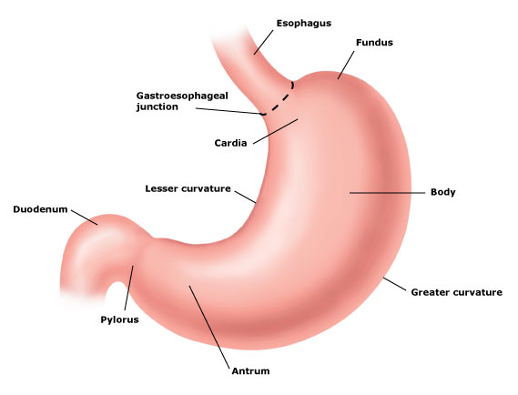

Slide 4
Word element | Refers to
abdomin/o, lapar/o | abdomen
bucc/o | cheek
chol/e,chol/o | bile, gall
cholecyst/o | gallbladder
col/o, colon/o | colon
-emesis | vomit
enter/o | intestine
gastr/o | stomach
gingiv/o | gums
hepat/o | liver
-lith | stone
-pepsia | digestion
-phagia | eat or swallow
proct/o | anus and rectum
sial/o | salivary glands
stomat/o | mouth

Slide 5
The upper tract:
The upper GI tract consists of the mouth, pharynx, esophagus and the stomach. The stomach is composed of four parts: the fundus, the cardia, the body, and the antrum
The sphincter between the esophagus and stomach is called the cardiac sphincter. The sphincter between the stomach and duodenum is called the pyloric sphincter.
The lower GI tract:
The lower GI tract consists of the intestines and the anus. The small intestine is divided into three parts: the duodenum, jejunum, and ileum.
The large intestine divided into three parts: the cecum, colon and rectum. (the colon is divided into four parts: the ascending colon, transverse colon, descending colon and sigmoid colon.
The sphincter that controls the flow from the ileum to the cecum is called the ileoceccal sphincter.
Attached to the cecum is a blind tube called the vermiform appendix.; the single word appendix is the preferred term.
The operation of the digestive tract has two terms that describe how it moves its contents along from one part to the next:

Slide 6
Accessory organs: The accessory organs are salivary glands, liver, gallbladder and pancreas Disorders of upper GI Tract:-
Term | Meaning
stomatitis | inflammation of the mouth
gingivitis | inflammation of the gums
*dysphagia | difficulty in swallowing
gastric ulcers | erosion of the gastric mucosa
GERD (gastroesophageal reflux disease) | upward flow of the stomach acid into the esophagus
*Note: dys- means difficulty
Term | Meaning
deglutition | swallowing
peristalsis | wave-like muscular contractions that move food along in the digestive tract.

Slide 7
Disorders of the lower GI tract:
Term | Meaning
Crohn'sdisease | inflammation of the mucosal lining of the intestine (usually the small intestine)
appendicitis | inflammation of the appendix
Disorders of the accessory organs of the digestive system:
Term | Meaning
cholelithiasis | presence of stones in the gallbladder or common bile duct
cholecystitis | inflammation of the gallbladder
jaundice | yellowish cast to the skin, sclera, and mucous membranes caused by bile deposits
cirrhosis | chronic disease of the liver in which the liver becomes firm and nodular.

Slide 8
A few additional conditions, symptoms, or disorders of the digestive system include:
Term | Meaning
anorexia | loss of appetite
bulimia | eating disorder characterized by binge eating followed by self-induced vomiting and misuse of laxatives
dyspepsia | impairment of digestion
diarrhea | frequently loose or watery stools
constipation | decrease in the frequency of bowel movements, difficulty in passing stool and/or hard dry stools.
hemorrhoids | enlarged veins in or near the anus that may cause pain or bleeding.

Slide 9
Specialties and specialists of the digestive system:
Term | Meaning
gastroenterologist | a specialist in the diagnosis and treatment of digestive system disorders.
gastroenterology | the specialty concerned with the digestive system.
proctologist | a specialist in the diagnosis and treatment of rectal and anal disorders
proctology | Study of the rectum and anus

